Slide 3

Stéphane van Gulick
Former 8 year Microsoft MVP (PowerShell)
Trainer
Automatisation
Powershell
Pester
Devops (CI/CD)
Devops Engineer

Slide 4
This Session
PSHTML fundamentals
Web dev skills
Static html pages
Dynamic html pages
Create a web application with Powershell
Notes:
Please invest some time to reconsider your session: what is it that audience can get out of it? Try and be as precise as you can. If you are showing solutions, then focus on “how to”. If you present about a general technology, you’ll want to stick to “Be able to” or “Understand why/how”.

Slide 5
Agenda
Introduction to PSHTML
What it is?
How to use it?
Basic and advanced functionality
Introduction to Polaris
What it is?
Basic use case
Using PSHTML and Polaris together
Notes:
Psconf.eu is about demos and code. Try and minimize use of text slides

Slide 6
Introduction to PSHTML

Slide 7
What is PSHTML ?
Cross platform powershell module
Reproduces HTML language
Domain Specific Language (aka DSL)
Integrates very well with PowerShell

Slide 8
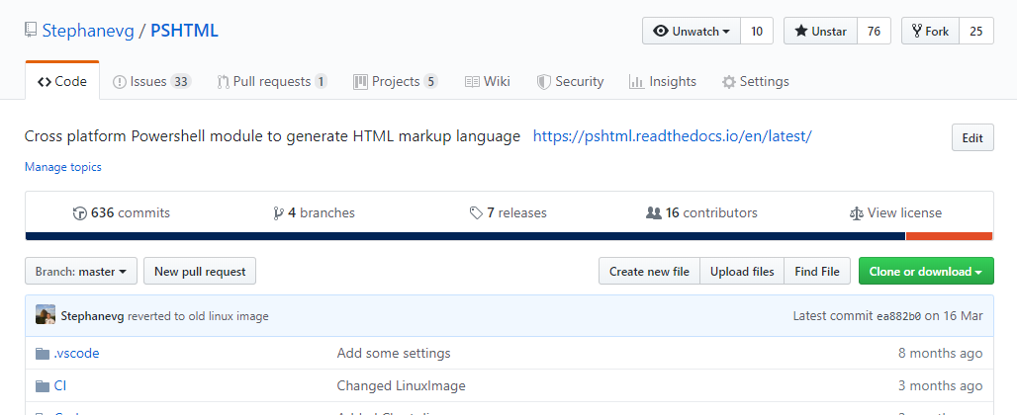
PSHTML
Getting started -> https://pshtml.readthedocs.io/en/latest/
Github -> https://github.com/Stephanevg/PSHTML

Slide 9
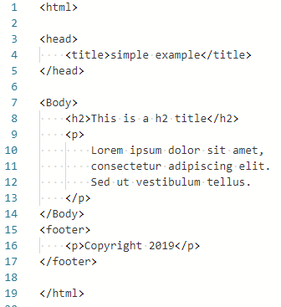
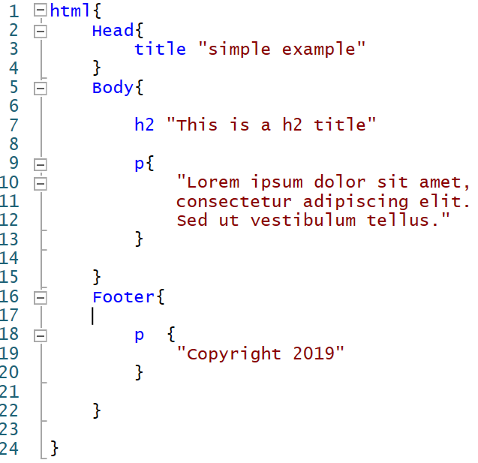
PSHTML
HTML
PSHTML

Slide 10
Demos
We love Demos!

Slide 11
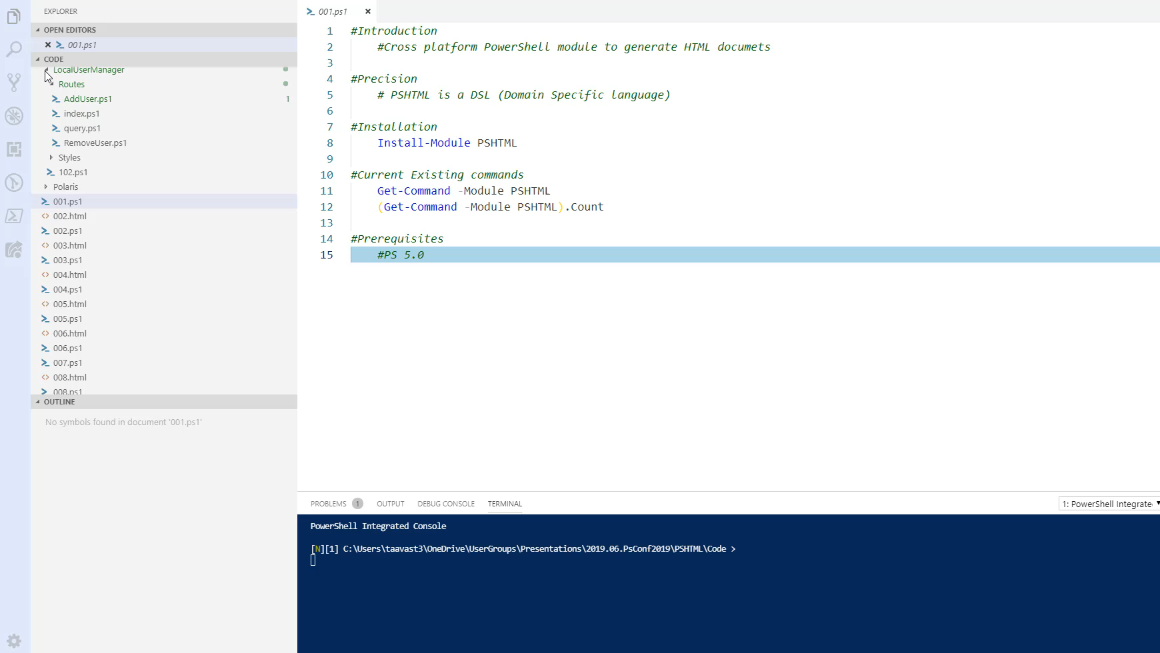
Notes:
How to install
Number of commands
Basic html page

Slide 12
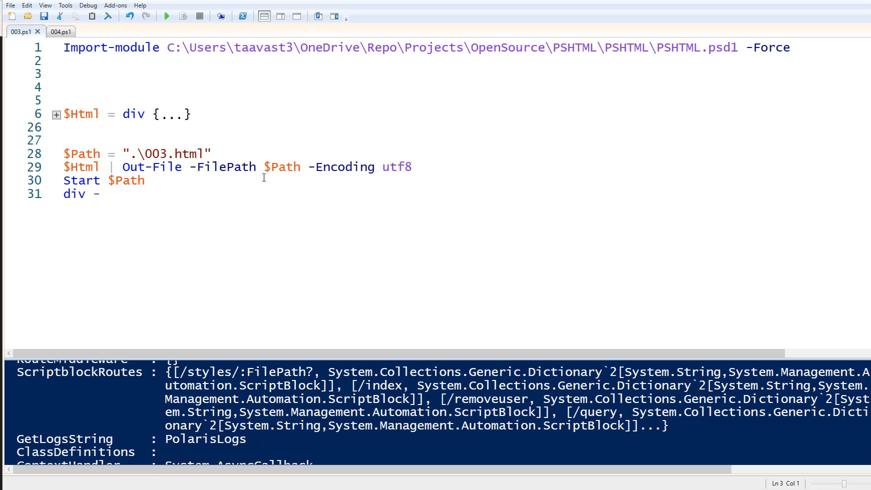
Notes:
Show tags
Id,Class,Style,attributes,content (003.ps1)
Create table raw (004.ps1)
Create table using ConvertTo-PSHTMLTable (005.ps1)

Slide 13
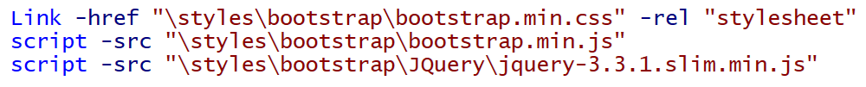
Cmdlet structure / HTML Tags
TagName
link
Content
href
Id
rel
Class
Style
Attributes
Notes:
-link
-href are actually attributes from 'link' tag

Slide 14
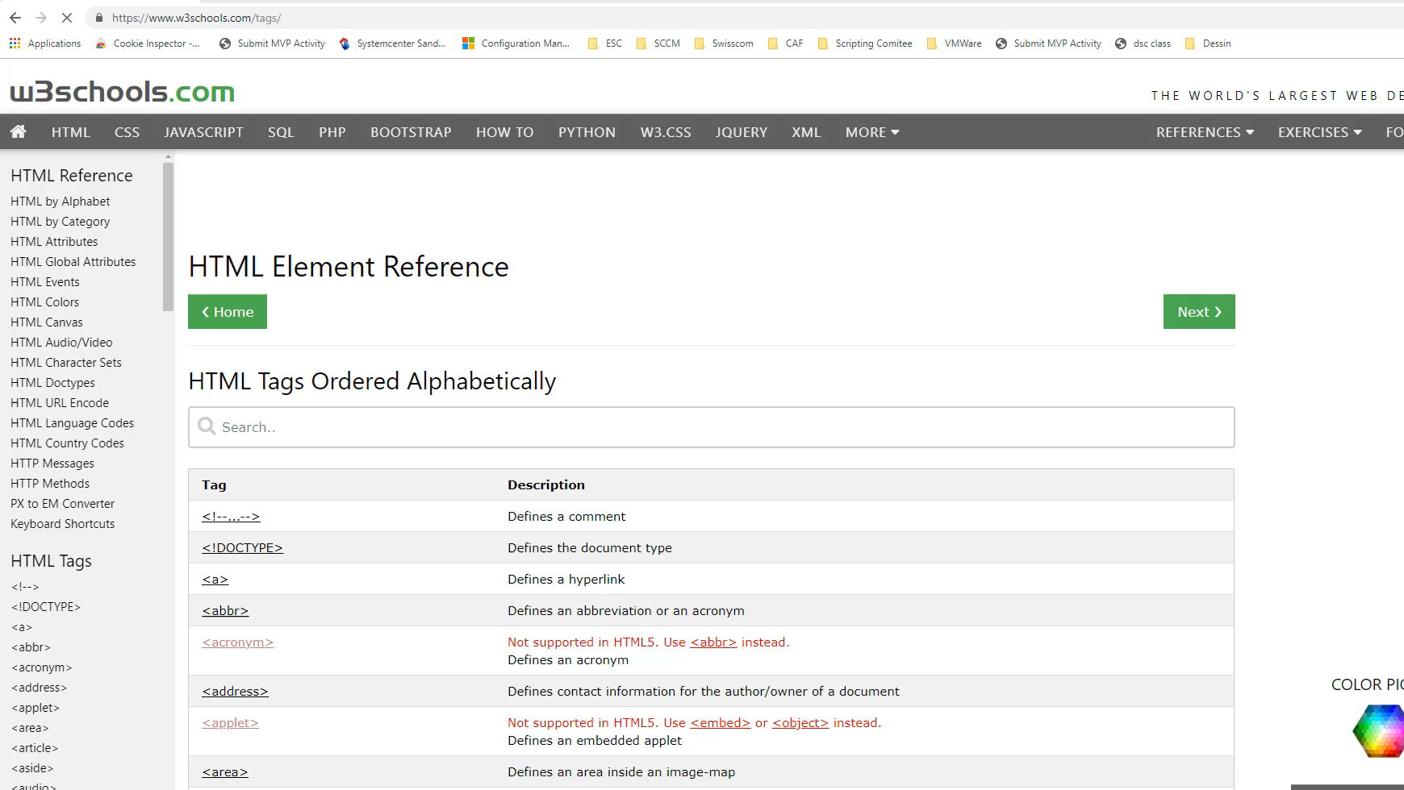
Notes:
1min20

Slide 15
Missing tag / Attribute?
All HTML tags 'should' be available
Missing attribute? -> Use -Attributes
Open issue -> https://github.com/Stephanevg/PSHTML/issues

Slide 16
PSHTML Tables
Tables
Create full structure
Dynamically generated
Table,Thead / Tr / tbody…
ConvertTo-PSHTMLTable

Slide 17
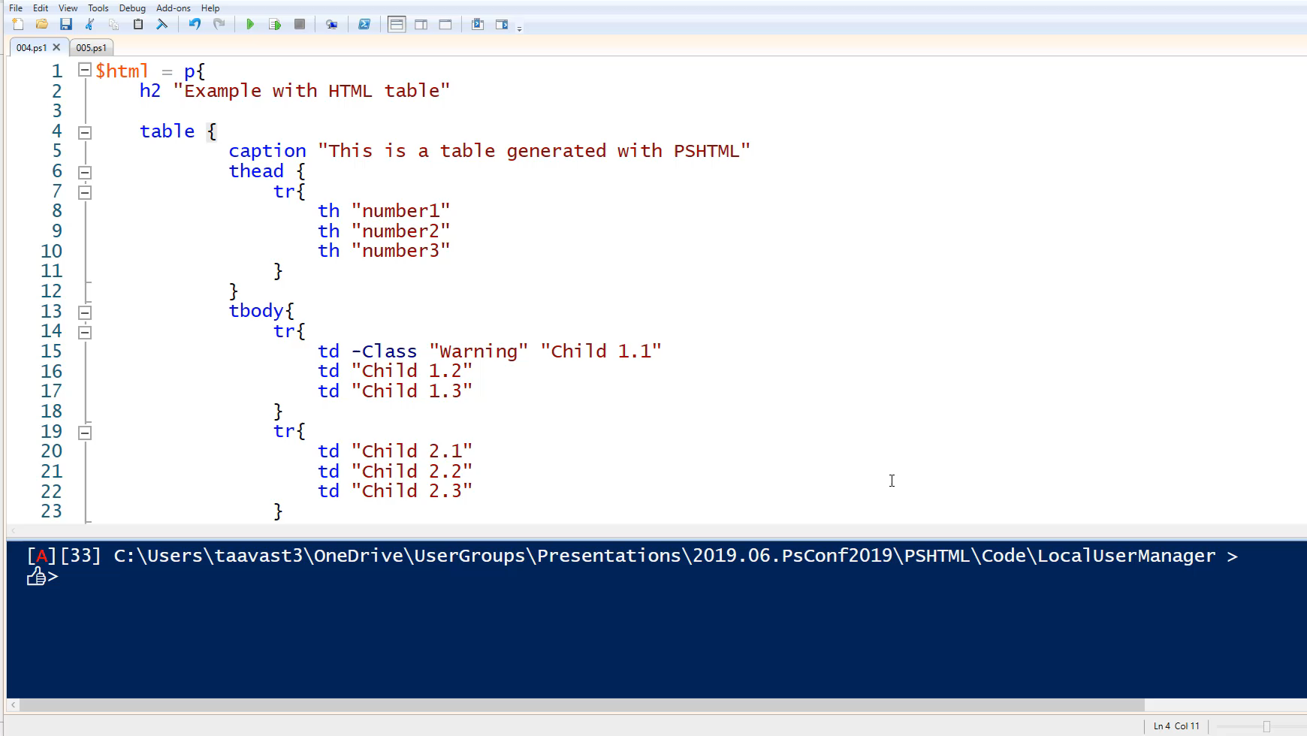

Slide 18
PSHTML Includes
Reusing same code across pages

Slide 19
PSHTML: Includes
Encapsulate identical code blocks
Code reuse
Reduce the refactoring scope

Slide 20
Demos
We love Demos!

Slide 21
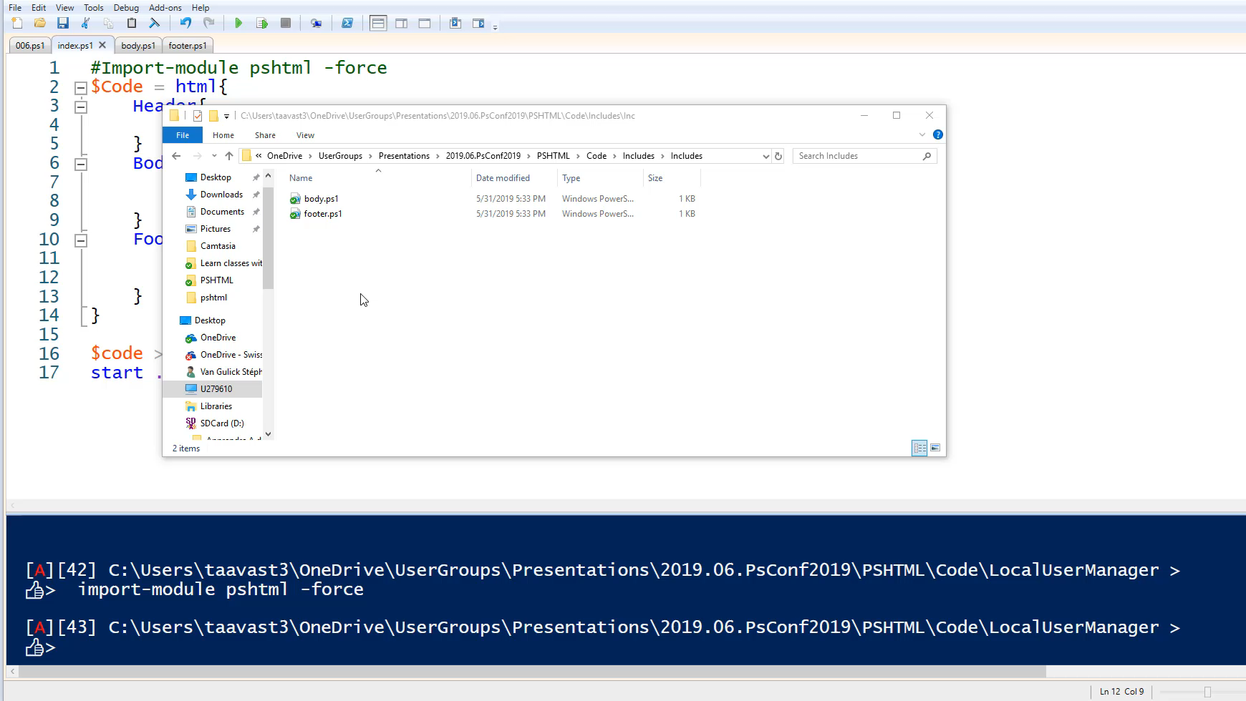

Slide 22
PSHTML: Using powershell
Adding logic and using powershell modules

Slide 23
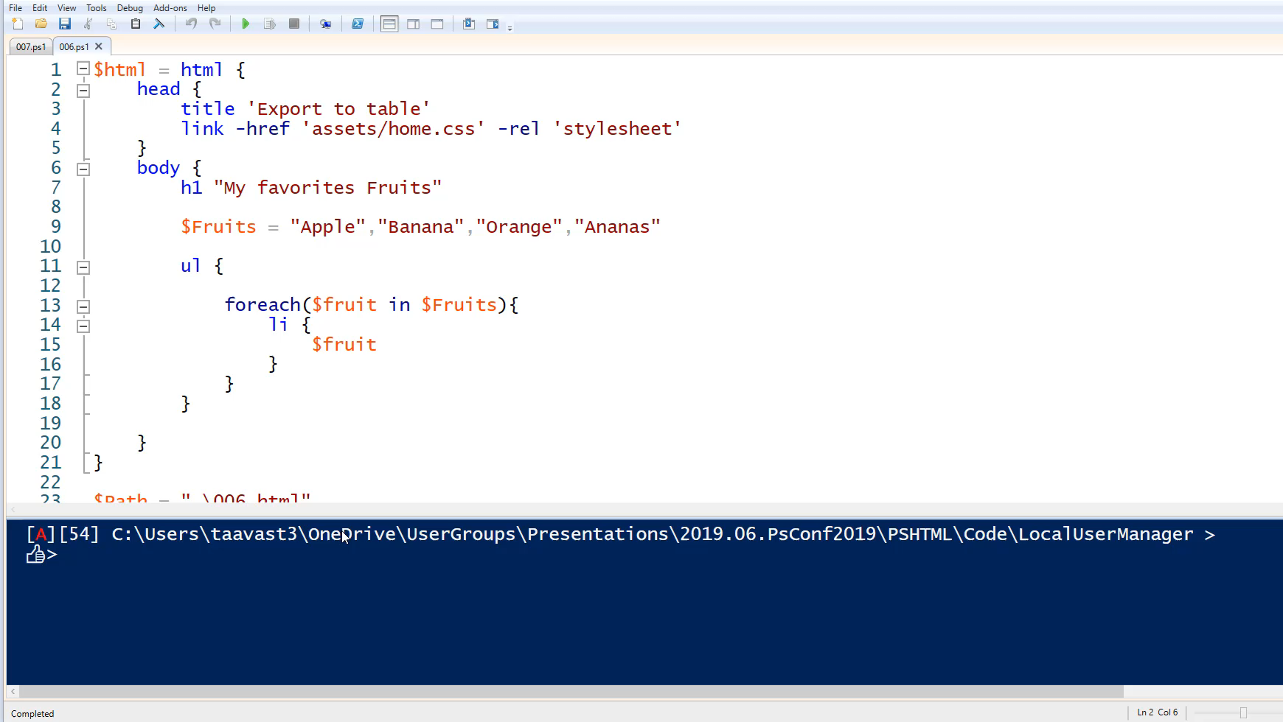

Slide 24
Working with Assets
Adding power to your HTML pages

Slide 25
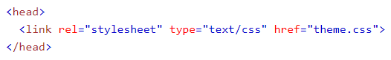
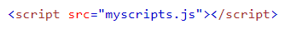
PSHTML Assets
CSS
Scripts (Javascript)

Slide 26



PSHTML Assets

Slide 27
Demos
Using assets – integrating external libraries in your PSHTML scripts

Slide 28
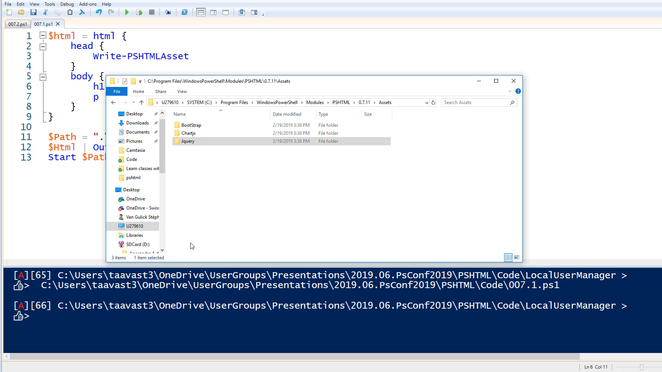

Slide 29
Making it look pretty
Using bootstrap

Slide 30
Twitter Bootstrap
Simplify styling
Responsive
Very popular in web dev community
Super easy to use

Slide 31
Demos
Developing with PSHTML and Bootstrap

Slide 32
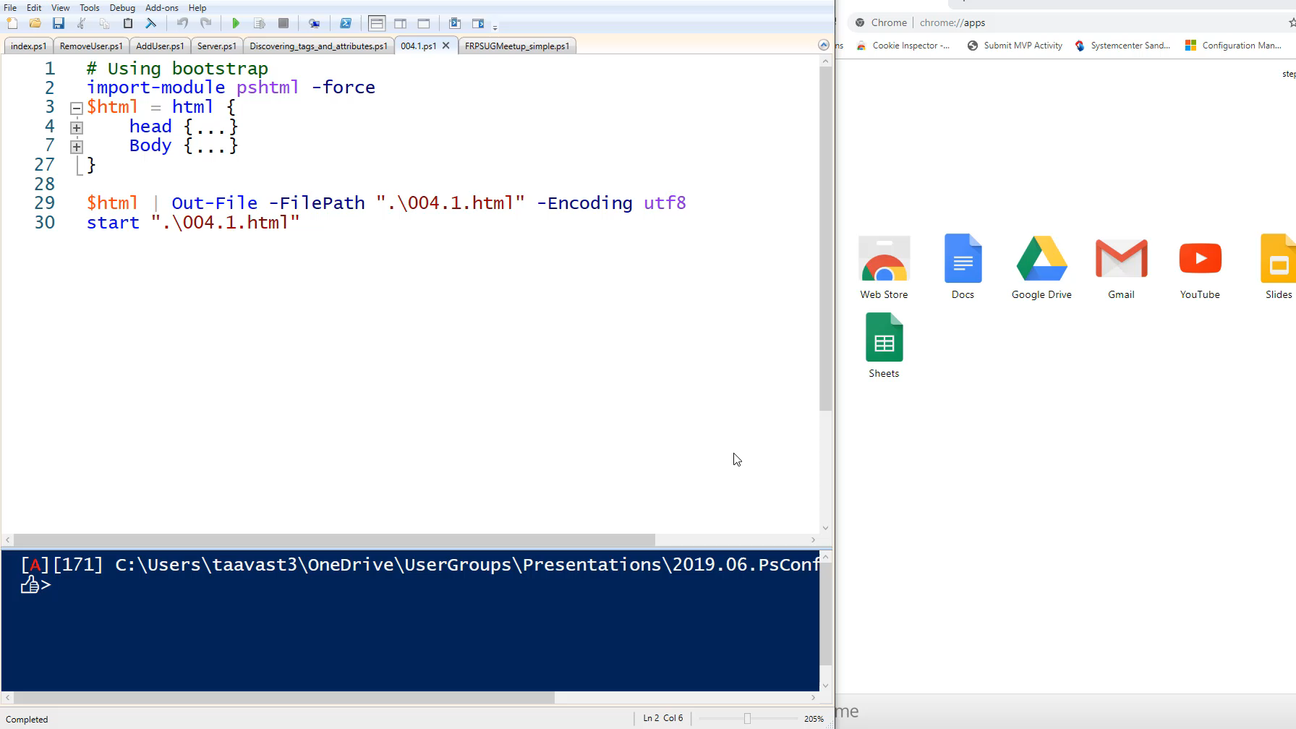
Notes:
1min59

Slide 33
Generating Charts in PSHTML
Using Chart.js

Slide 34
PSHTML Charts
Since version 7.1
Uses chart.js library
Draws the charts on canvas

Slide 35
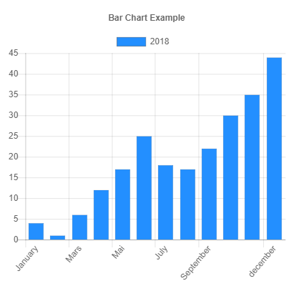
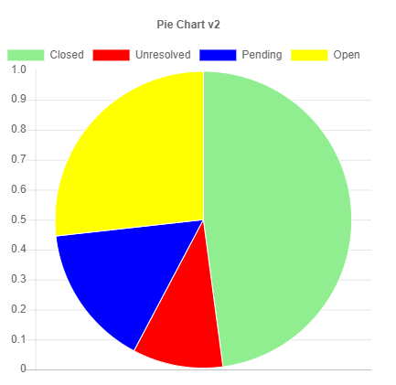
PSHTML Charts

Slide 36
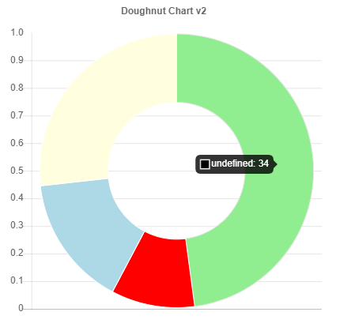
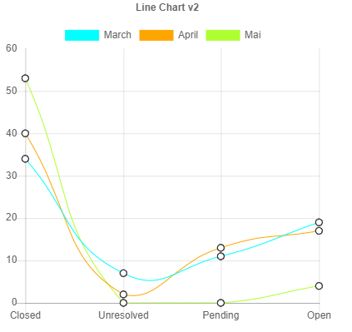
PSHTML Charts

Slide 37
PSHTML Charts
Script
Data
2,0,1,4,2
DataSet
Data
Label
Colors
Chart
DataSet
Labels
CanvasID
Notes:
$dsb2 = New-PSHTMLChartBarDataSet -Data $data2 -label "April" -BackgroundColor ([Color]::red)
$dsb3 = New-PSHTMLChartBarDataSet -Data $data3 -label "Mai" -BackgroundColor ([Color]::Green )
New-PSHTMLChart -type bar -DataSet $dsb1,$dsb2,$dsb3 -title "Bar Chart v2" -Labels $Labels -CanvasID $BarCanvasID

Slide 38
Demos
PSHTML Charts

Slide 39
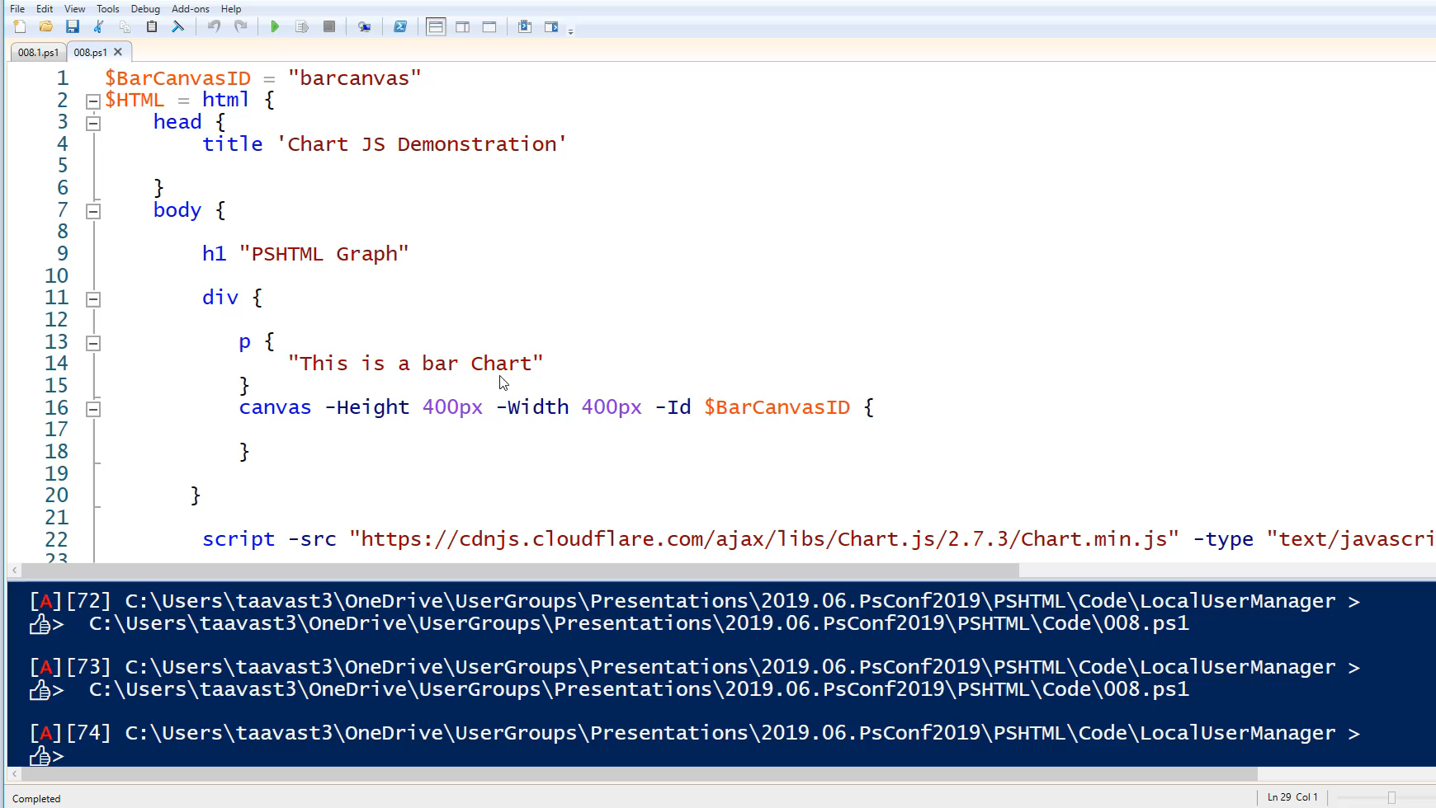
Notes:
1m14
Simple bar Chart
Generate 4 charts

Slide 40
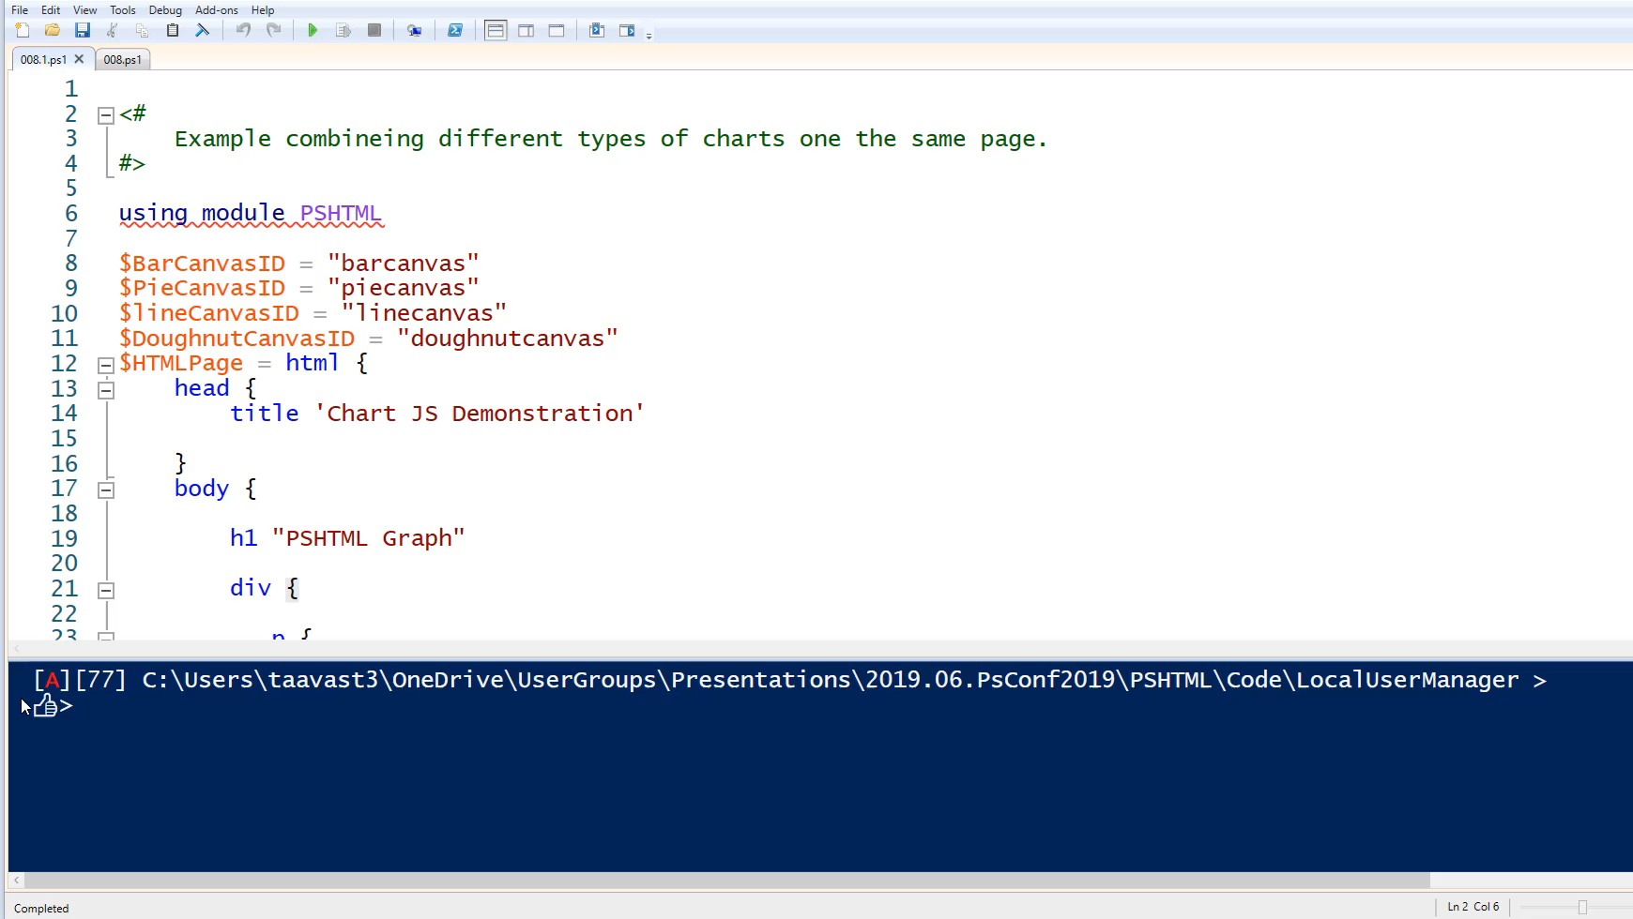

Slide 41
Combining everything together

Slide 42
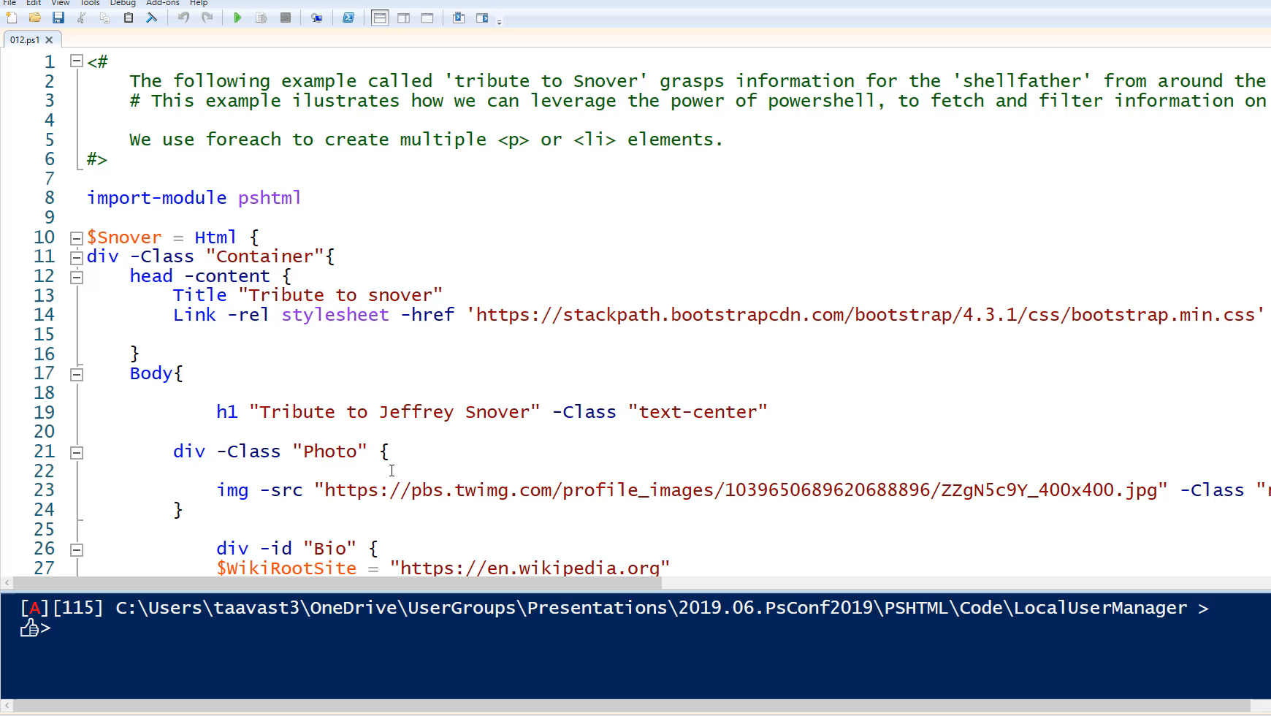
Notes:
Snoverism
Meetup data page

Slide 43
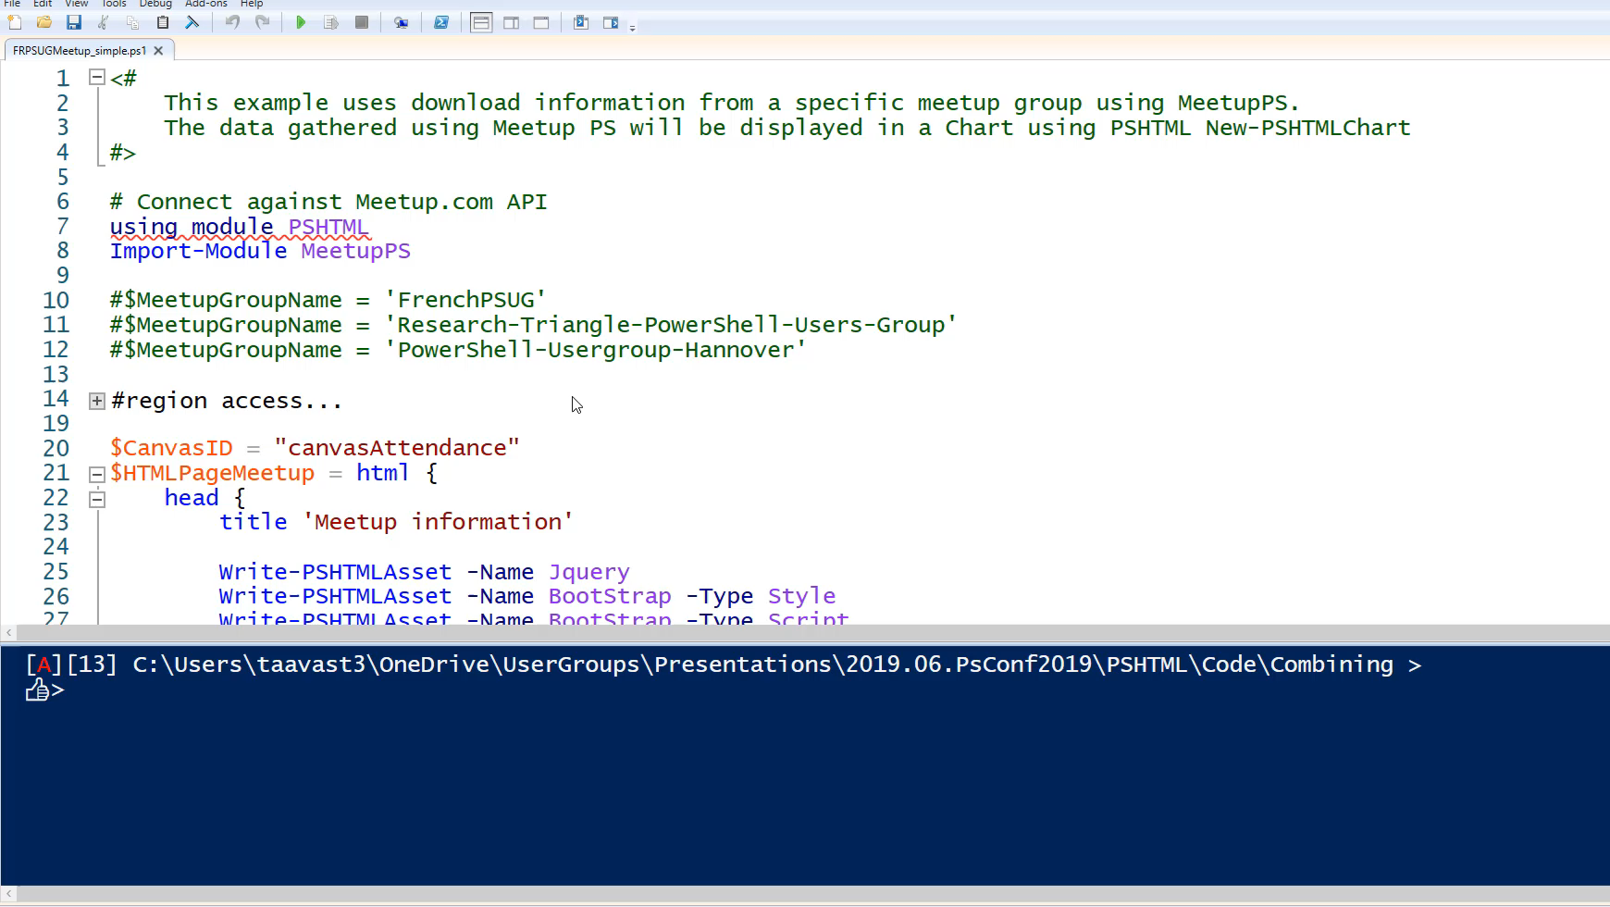
Notes:
1min39

Slide 44
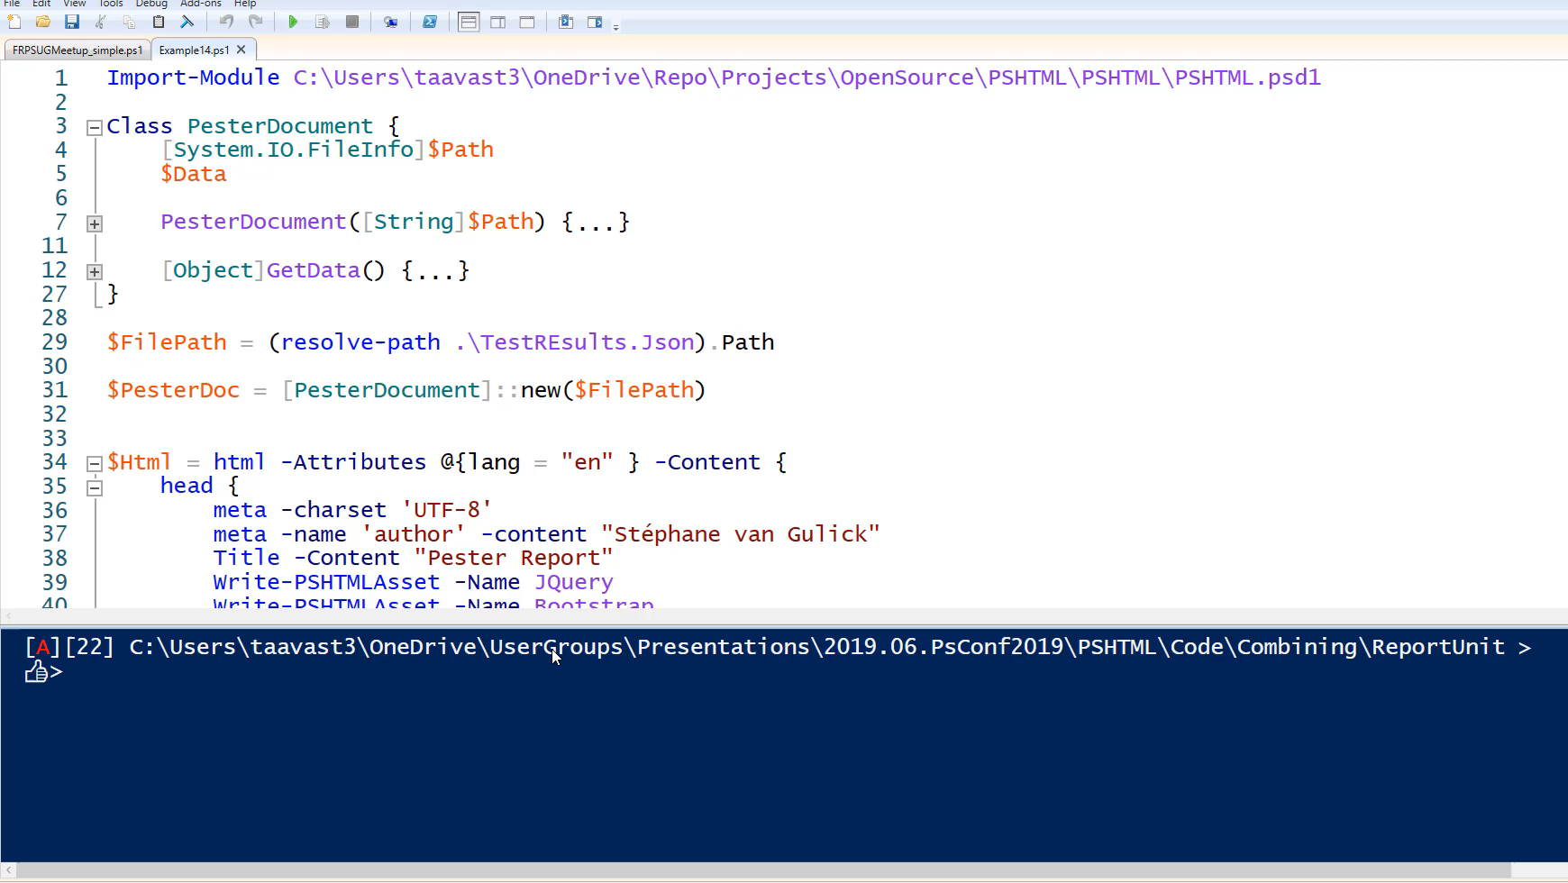

Slide 45
Snippets

Slide 46
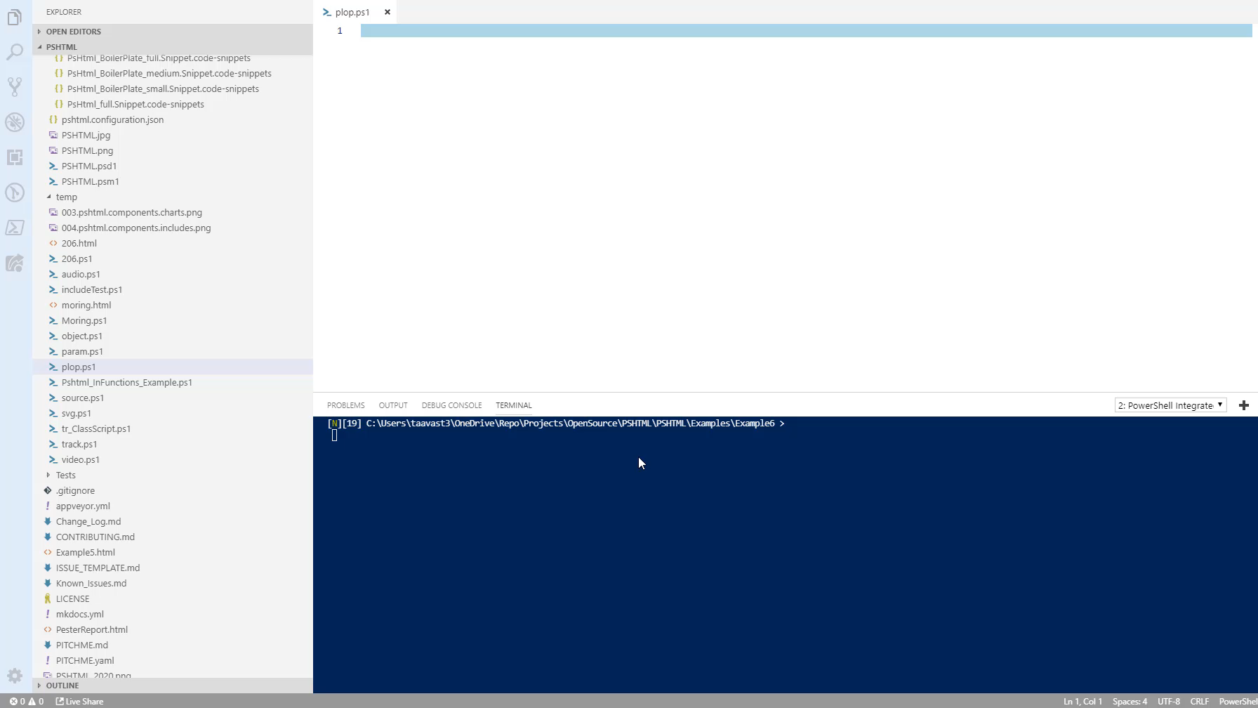
Notes:
36s

Slide 47
Introduction to Polaris
Creating the backend

Slide 48
Polaris
A cross-platform, minimalist web framework for PowerShell
Open source project (MIT)
Tyler Leonhardt - @TylerLeonhardt / Micah Rairdon - @tiberriver256
https://github.com/PowerShell/Polaris

Slide 49
Demos
Introduction to Polaris

Slide 50
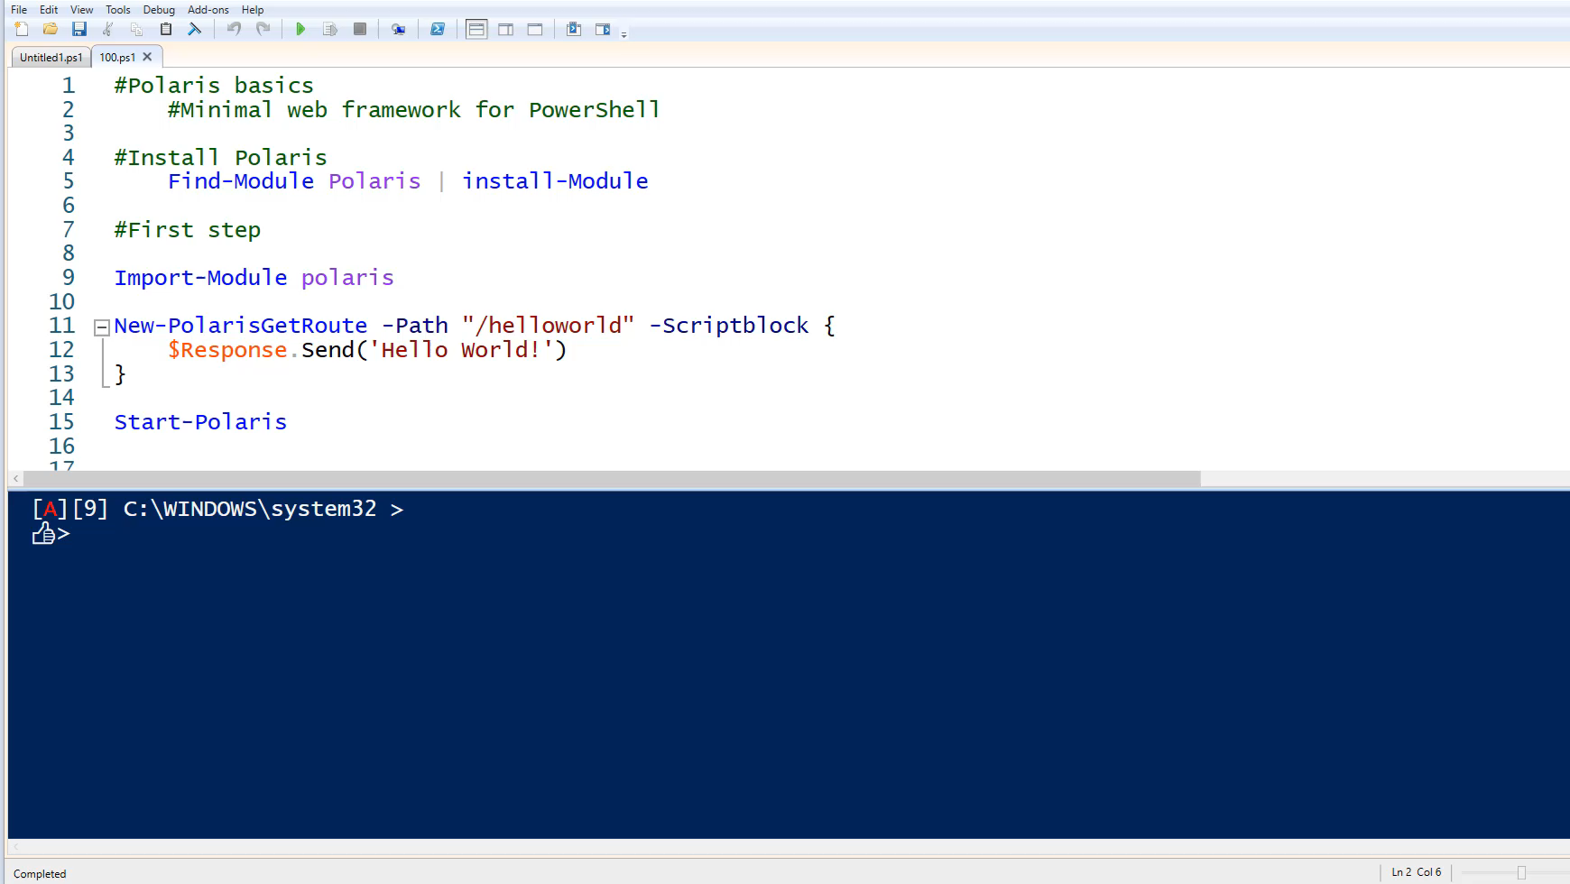

Slide 51
Create routes : New-PolarisRoute –Method
GET,POST,DELETE,PUT
Set content type
Text/plain
Text/json
Text/html
Publish static files : Publish-StaticRoute (optional)
Start the server : Start-Polaris

Slide 52
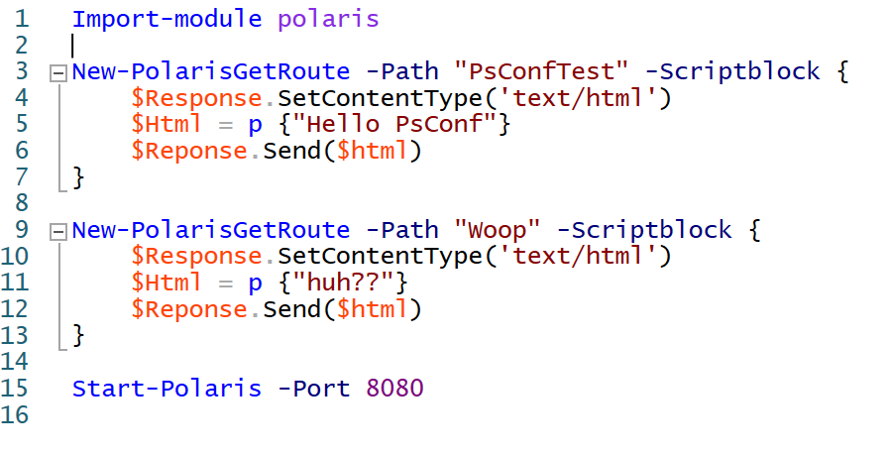

Slide 53
Demos
Combining PSHTML + Polaris

Slide 54
Combining PSHTML + Polaris

Slide 55
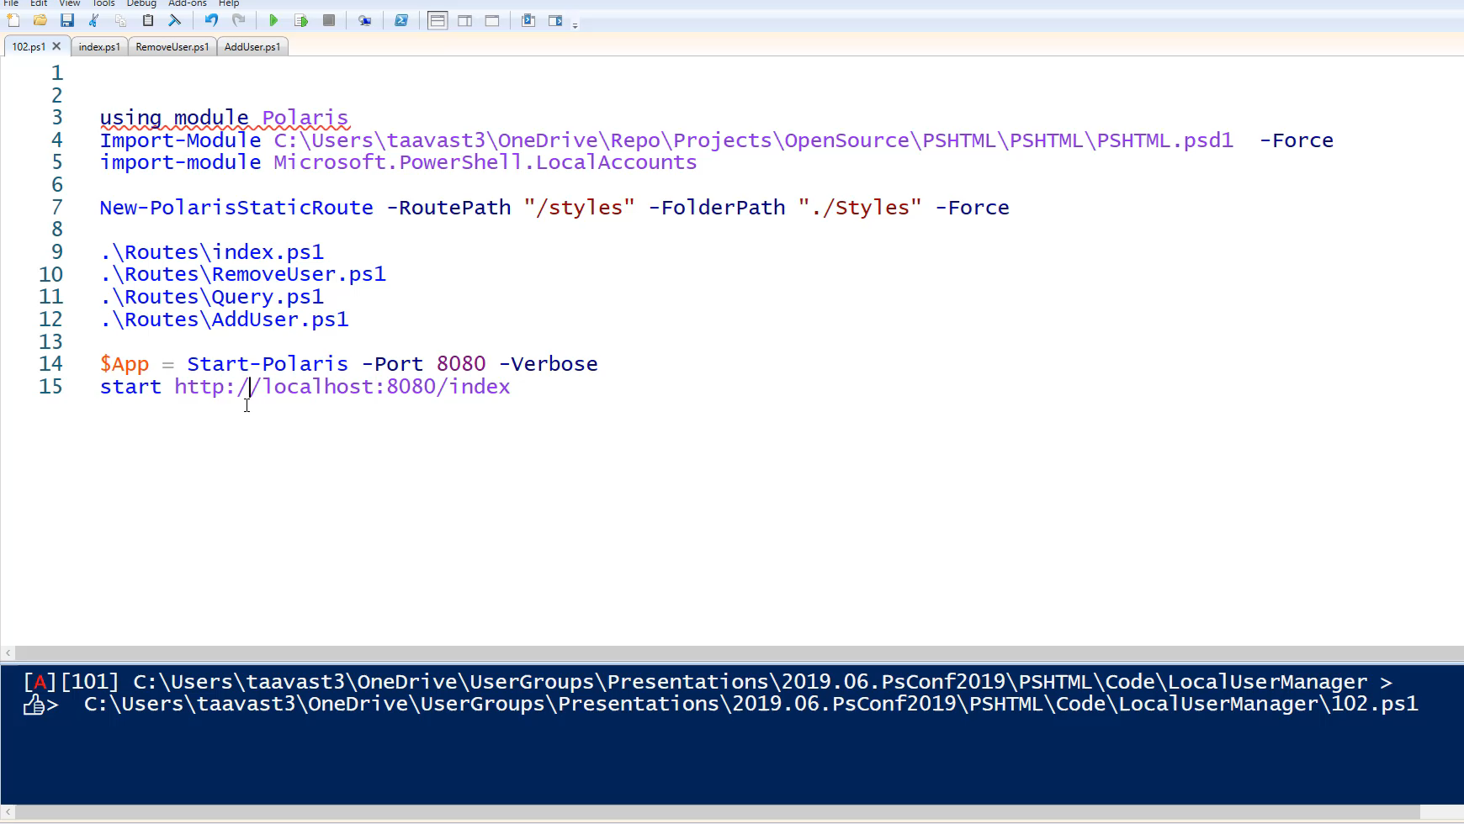
Notes:
1min47

Slide 56
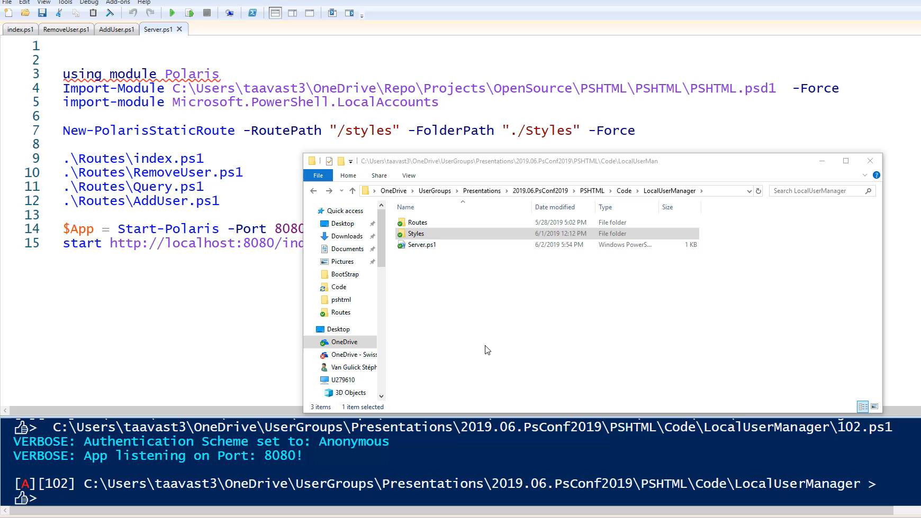
Notes:
2min35

Slide 57
PSHTML in the field
Projects using PSHTML in production / open source projects

Slide 58
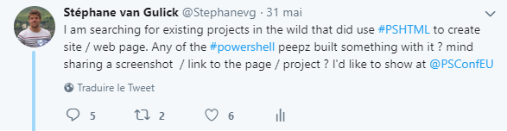

Slide 59
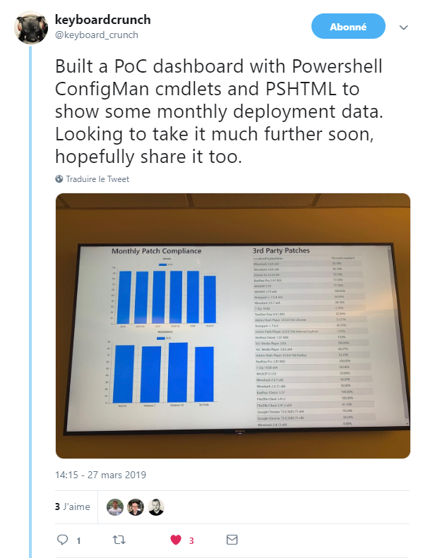

Slide 60
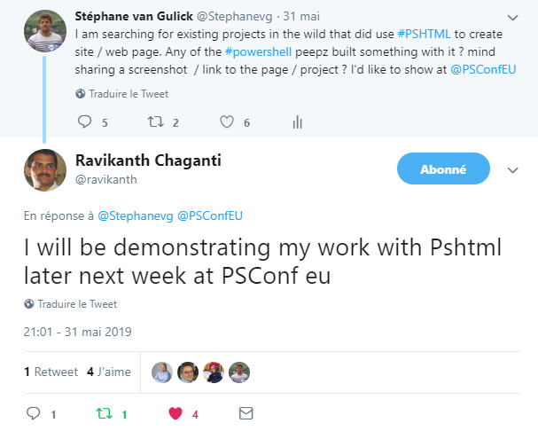

Slide 61
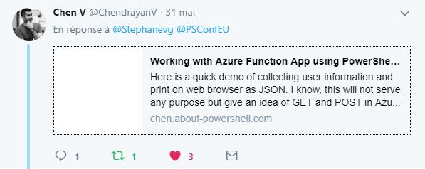
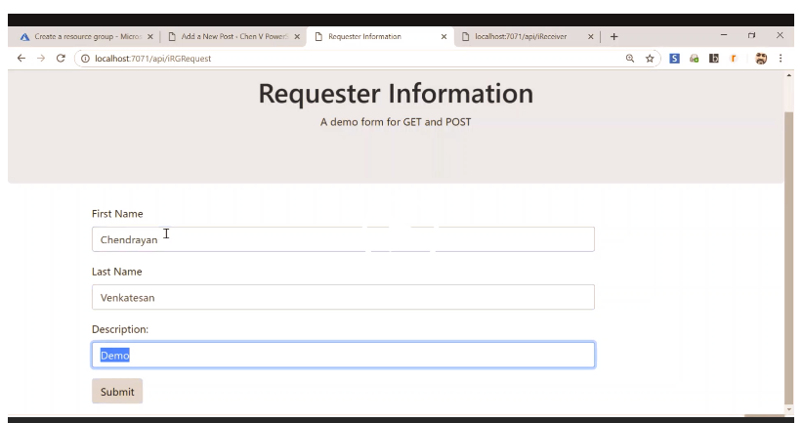

Slide 62
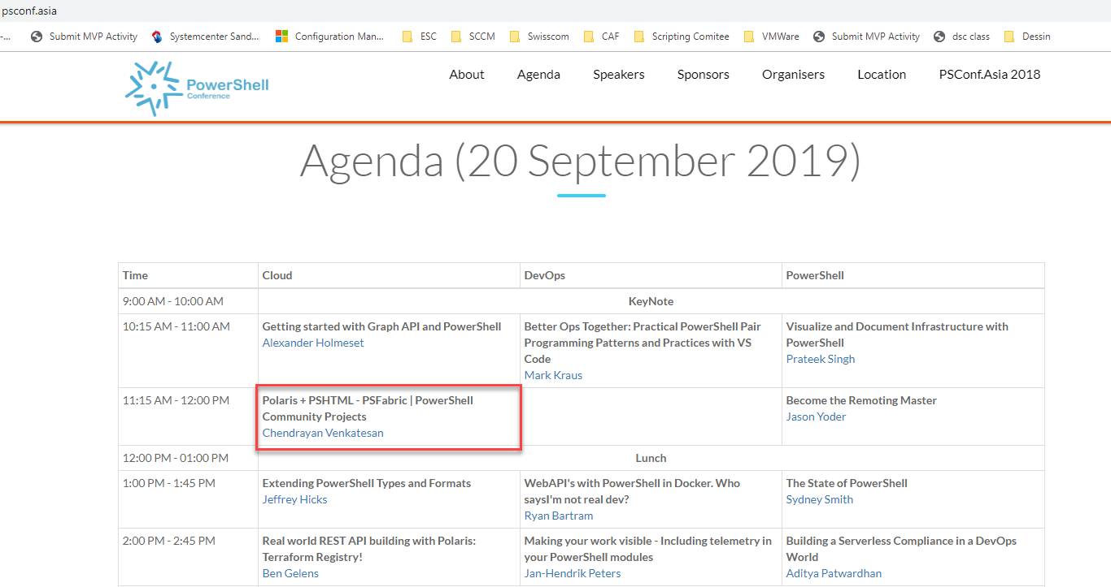

Slide 63
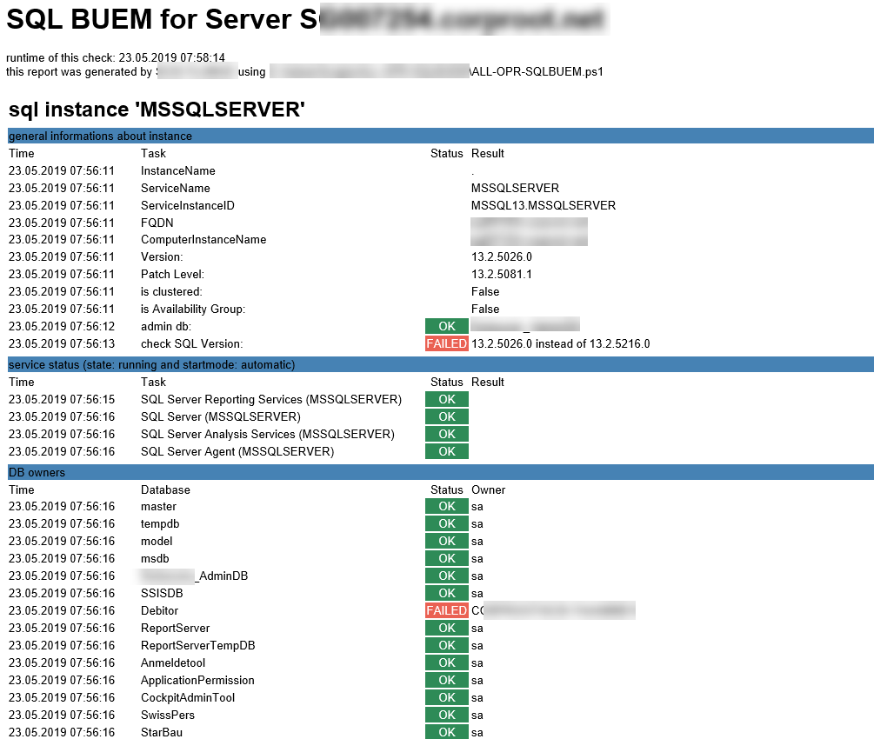

Slide 64
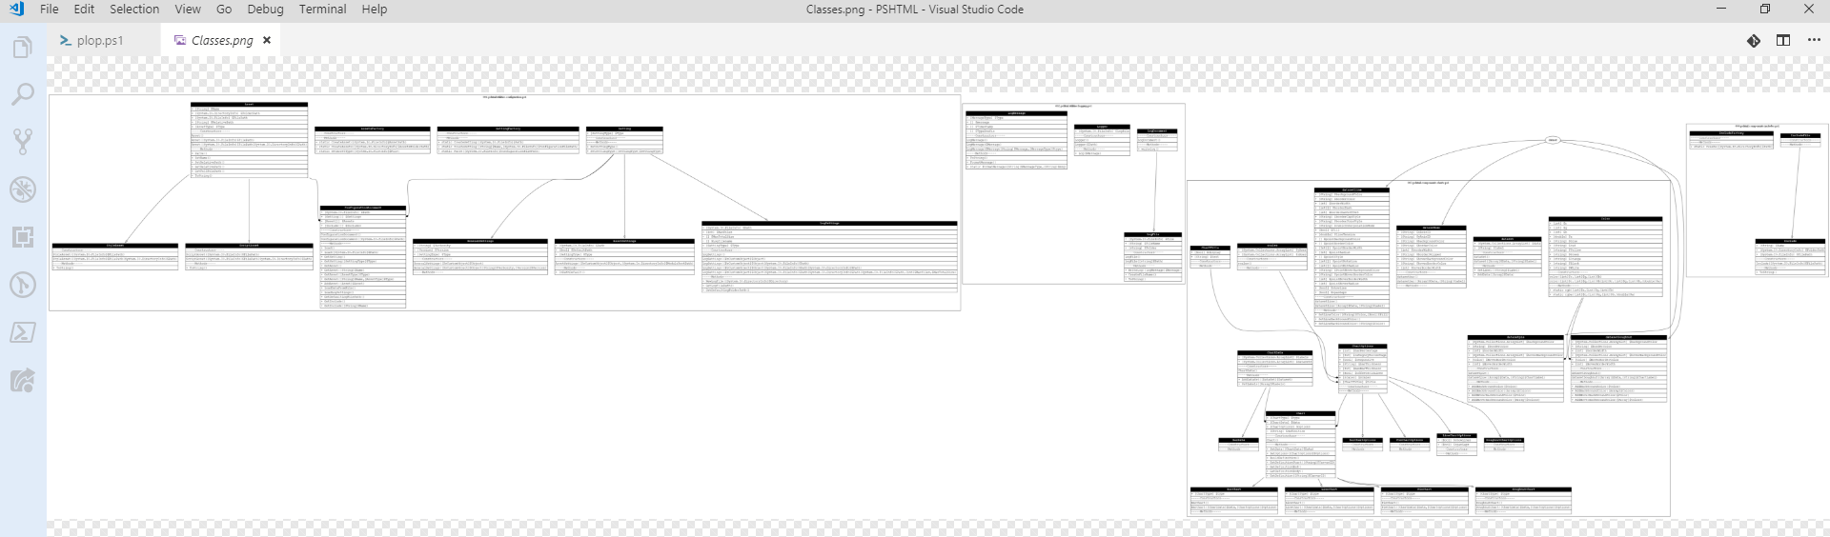
PSHTML Structure

Slide 65
Summary
Basics of PSHTML
Basics of Polaris
Used assets
Created Charts
Used existing modules
Created static pages
Create dynamic web pages
Created a web application
Notes:
Sum up your key messages

Slide 66
Links
Read the docs -> https://pshtml.readthedocs.io/en/latest/
Github -> https://github.com/Stephanevg/PSHTML
PSHTML and NodeJs -> http://chen.about-powershell.com/2018/12/experiment-using-pshtml-in-node-js-and-host-a-azure-web-app/
PSHTML and GO -> http://chen.about-powershell.com/2019/01/build-web-app-using-powershell-pshtml-module-in-go-lang/
Polaris -> https://github.com/PowerShell/Polaris

Slide 67
Q&A
15 minutes

